Slide 1
Phases of Compiler

Slide 2
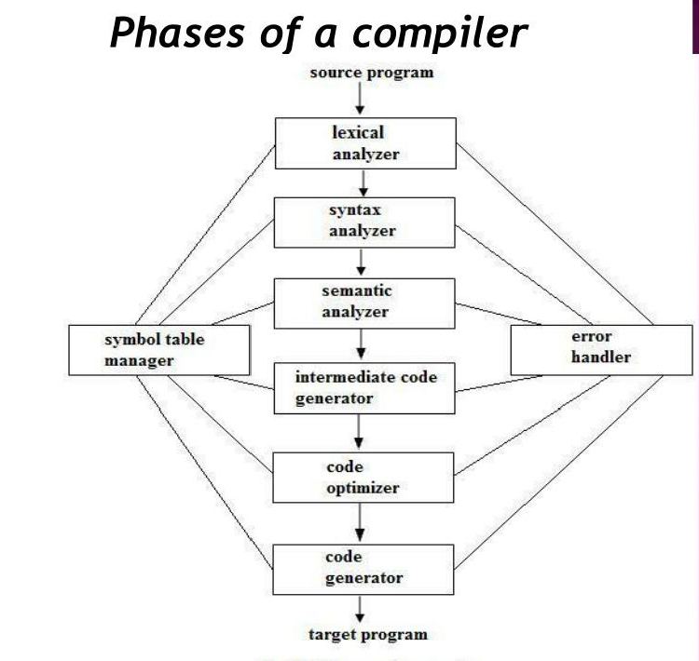
Phases of compiler

Slide 3
Lexical Analysis
The first phase of a compiler is called lexical analysis or scanning.
Reads stream of characters making up the source program and groups the characters into meaningful sequences called lexemes
For each lexeme, the lexical analyzer produces as output a token

Slide 4
Tokens are two kinds
— Specific strings: keywords, punctuation symbols
— Classes of strings: identifies, constants, labels
— Token is of the form
(token-name/type, attribute-value)
— Specific string have token type but no value
— Classes of string have both token type and value

Slide 5
— token-name is an abstract symbol that is used during syntax analysis
— attribute-value points to an entry in the symbol table for this token.
— Information from the symbol-table entry is need for semantic analysis and code generation.

Slide 6
-For example, a source program contains the assignment statement
position=initial + rate * 60
-Lexical analyzer produces sequence of 7 tokens
(id, 1) (=) (id, 2) (+) (id, 3) (*) (60)*
-where id is an abstract symbol standing for identifier and 1 , 2, 3 points to the symbol table entries for position, initial, rate.
-Token value represents an index in to symbol table where information about classes of strings are kept.
-The symbol-table entry for an identifier holds information about the identifier, such as its name and type
-passes token to the subsequent phase, syntax analysis.

Slide 7
Syntax Analysis
-The second phase of the compiler is syntax analysis or parsing.
-Use the token to create a tree-like intermediate representation that depicts the grammatical structure of the token.
-Grammatical structures are represented by parse tree.
-Another typical representation is syntax tree
-is a compressed representation of parse tree.
-Operators appears as the internal nodes and operands of the operators are the children of the node for that operator.

Slide 8
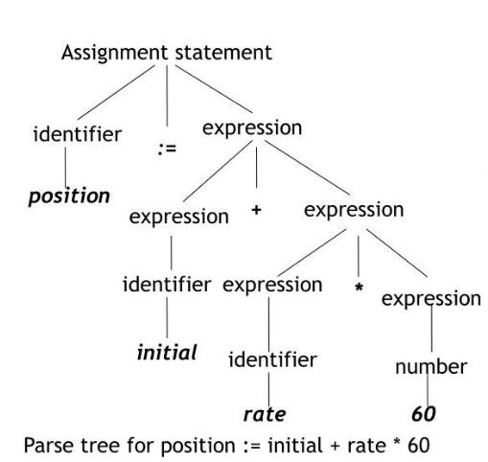

Slide 9
Semantic Analysis
-The semantic analyser uses the syntax tree and the information in the symbol table to check the source program for semantic consistency with the language definition.
-Type checking,
-where the compiler checks that each operator has matching operands.
for example, many programming language definitions require an array index to be an integer; the compiler must report an error if a floating-point number is used to index an array
-permit some type conversions called coercions
for example: position, initial, and rate are declared as floating-point, and 60 as integer. The type checker convert integer into a floating-point number.

Slide 10
Intermediate Code Generation
-Transform parse tree in to an intermediate language representation of the source program.
-An intermediate form is called three-address code
-which consists of a sequence of instructions with at most three operands per instruction

Slide 11
-For the above example, three address code is as follows
t1=inttofloat(60)
t2=id3*t1
t3=id2+t2
id1=t3
-Some properties of 3-address code
-Easy to produce
-Easy to translate in to target program.
-each three-address assignment instruction has at most one operator on the right side.
-the compiler must generate a temporary name to hold the value computed by a three-address instruction.
-some "three-address instructions" have fewer than three operands. (like the first and last instruction in the above eg.

Slide 12
Code Optimization
Attempts to improve the intermediate code so that better target code will result.
-Optional phase
-Produce a better target program that will run faster and take less memory and execution time
-In the above eg: the code can be optimized as
t1 = id3 * 60.0
id1= id2 + t1

Slide 13
Code Generation
-The code generator takes as input an intermediate representation of the source program and maps it into the target language.
-using registers R1 and R2, the above intermediate code is translated into the following machine code
MOVF id3, R2
MULF #60.0 , R2
MOVF id2, R1
ADDF R2, R1
MOVF R1,id1

Slide 14
Symbol-Table Management
-The symbol table is a data structure containing a record for each variable name, with fields for the attributes of the name.
-To record the variable names used in the source program and collect information about various attributes of each name.
-Provide information about the storage allocated fora name, its type, its scope
-In the case of procedures, the number and types of its arguments, the method of passing each argument(by value or by reference), and the type returned.

Slide 15
Error Handler
-Invoked when an error in the program is detected
-Common errors that are to be encountered are
-The lexical analyzer may be unable to proceed because the next token in the source program misspelled
-The parser may be unable to infer a structure because of a syntactic error like missing semicolon
-Semantic analyzer detect a construct having no meaning e.g. add array with a procedure
-The code optimizer may detect that certain statements can never be reached,
-While entering in to symbol table the book keeping routine may discover an identifier that has be multiply declared with contradictory attribute etc.

